Slide 1
Microsoft Purview API
Taygan Rifat, Cloud Solution Architect @ MSFT

Slide 2








Microsoft Purview
Interface
Governance Portal
Custom
Data Catalog | Data Map | Data Estate Insights | Data Policy | Management
Custom Connectors | Custom Lineage | Custom UX | …
Platform (REST API Endpoints)
Account
Catalog
Map & Discover
Policy Store
Scan
Account | Collection Resource Set Rule
Entity | Glossary | Lineage Relationship | Types | Search
Asset | Scan
Metadata Policies | Data Policies
Class. Rule | Credential | Source Scan | Filter | Ruleset | Trigger
Apache Atlas 2.2

Slide 3
🗺 What is Apache Atlas? "Apache Atlas provides open metadata management and governance capabilities for organizations to build a catalog of their data assets, classify and govern these assets and provide collaboration capabilities around these data assets for data scientists, analysts and the data governance team.“

Slide 4
🕒 Apache Atlas Milestones
2015-01-28 Hortonworks Establishes Data Governance Initiative
2015-05-06 Apache Atlas submitted to the Apache Software Foundation
2017-06-21 Apache Atlas graduates to a Top-Level Project
2018-06-02 Apache Atlas 1.0.0
2019-05-04 Apache Atlas 2.0.0
2020-07-15 Apache Atlas 2.1.0
2021-08-17 Apache Atlas 2.2.0 (Latest)

Slide 5
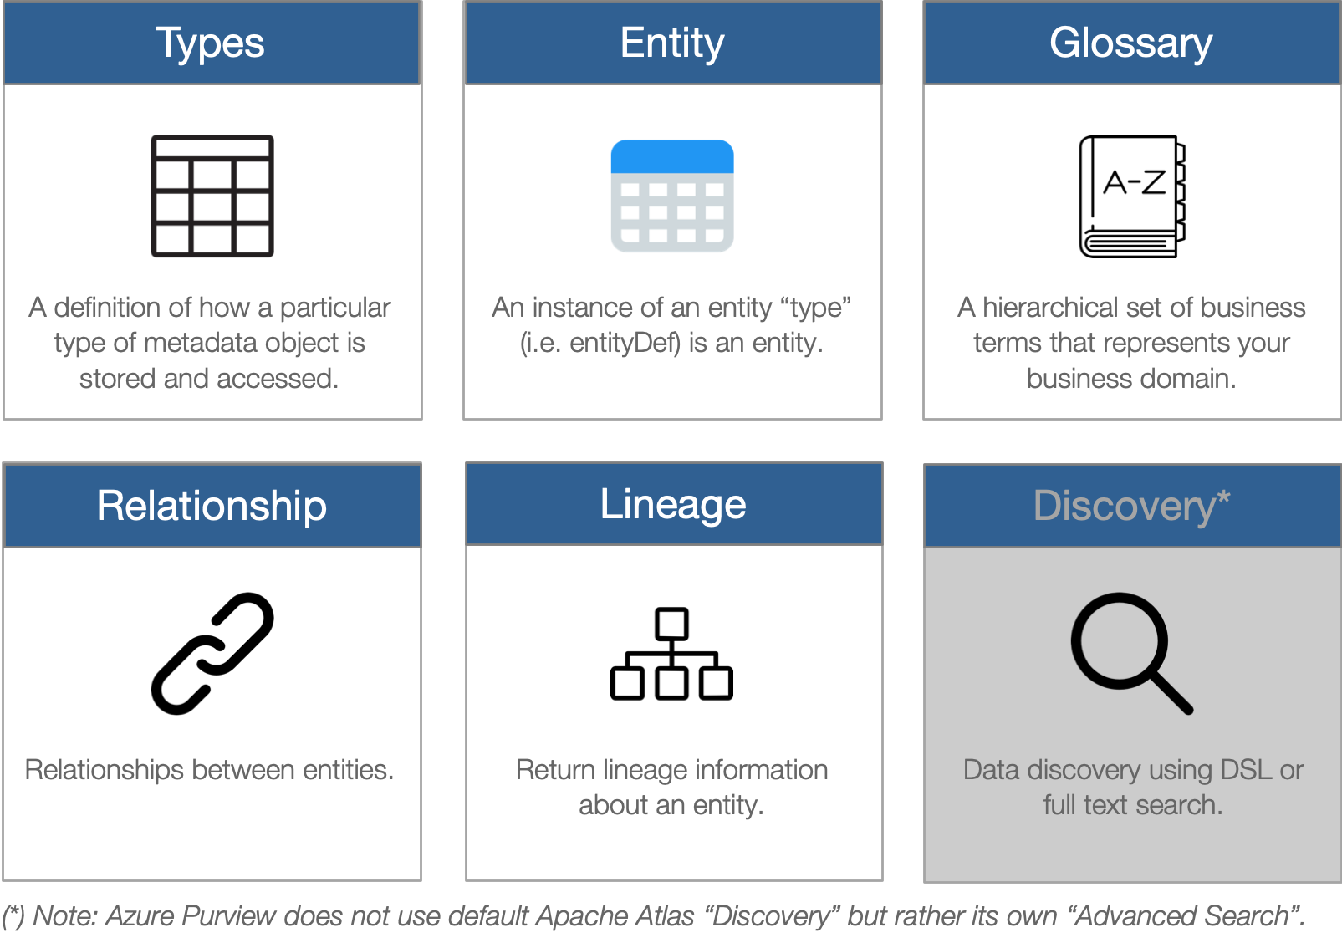
⚙ REST API Endpoints

Slide 6
🚀Getting Started
Create a Service Principal (Client ID, Tenant ID)
Generate a Client Secret
Configure Azure Purview to Trust the Service Principal
Generate an Access Token
You’re ready, read the swagger :)
https://aka.ms/purviewlab > REST API

Slide 7
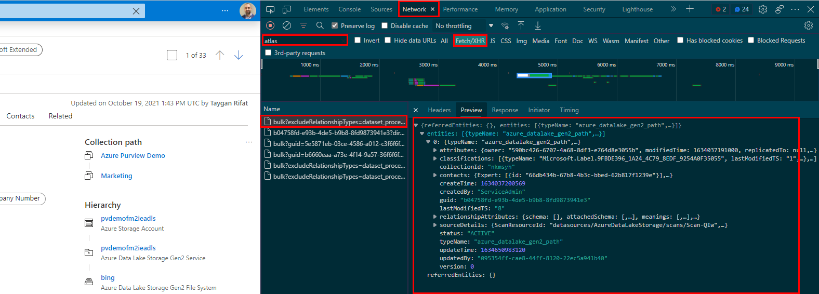
🐱‍💻Reverse Engineer Purview Studio
Navigate to Purview Studio (Edge/Chrome)
Open Developer Tools (F12)
Navigate to Network > XHR
Type “atlas” into the Filter
Start Browsing :)

Slide 8
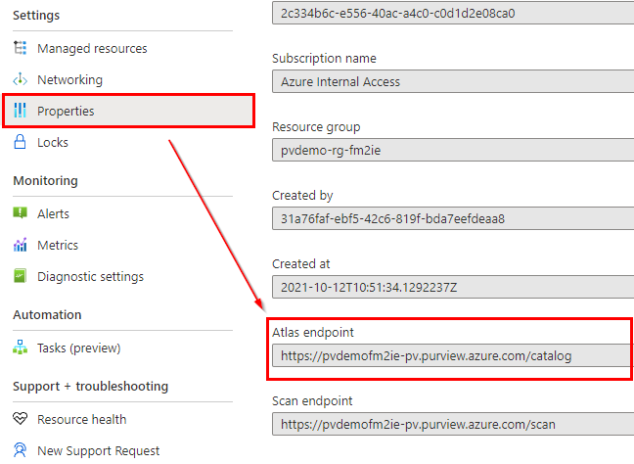
🗺Get Atlas Endpoint
Azure Portal > Purview Account
Properties
Atlas Endpoint

Slide 9
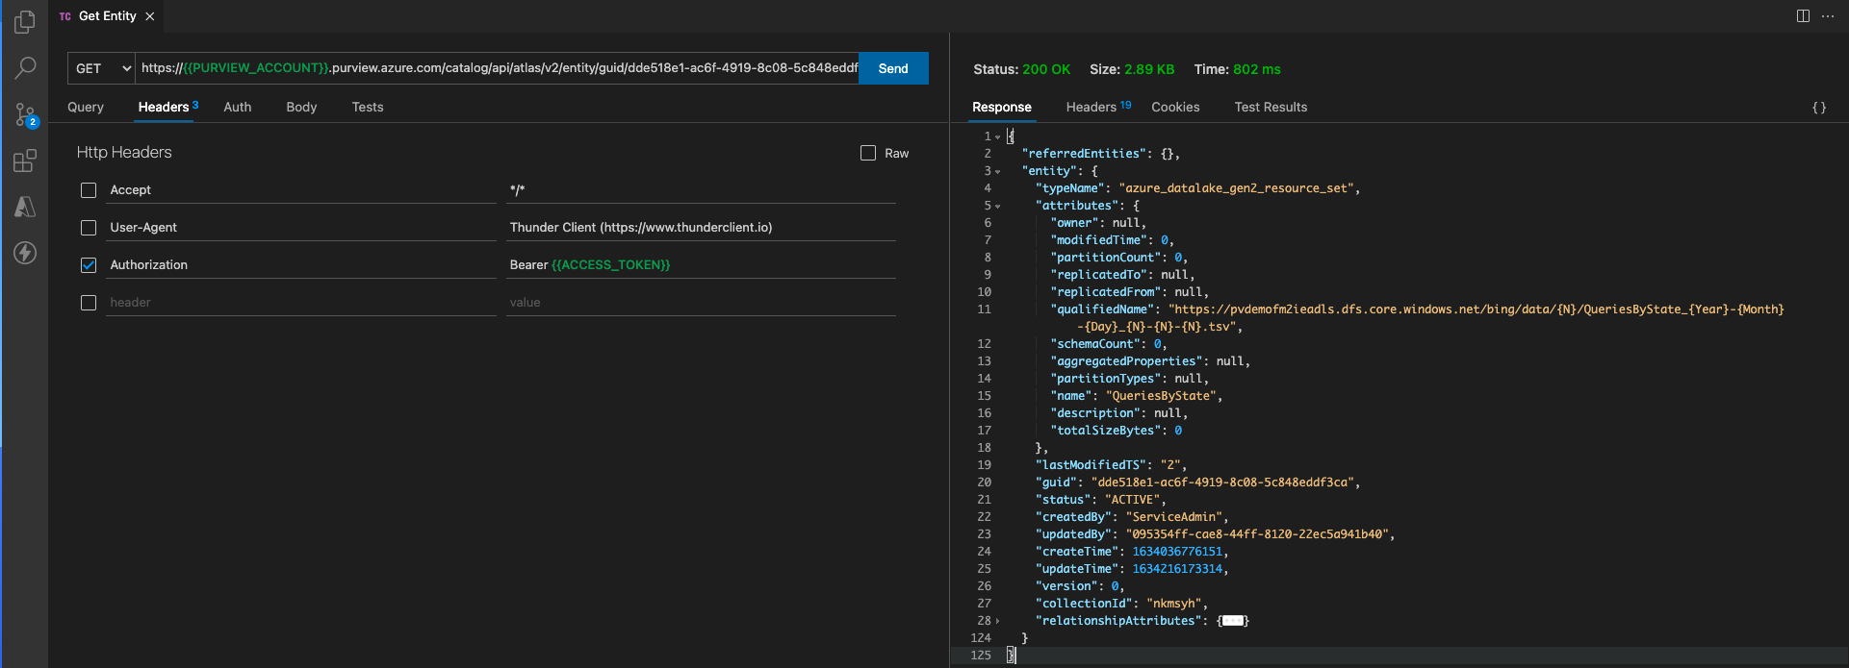
🎮 CRUD with Entities

Slide 10
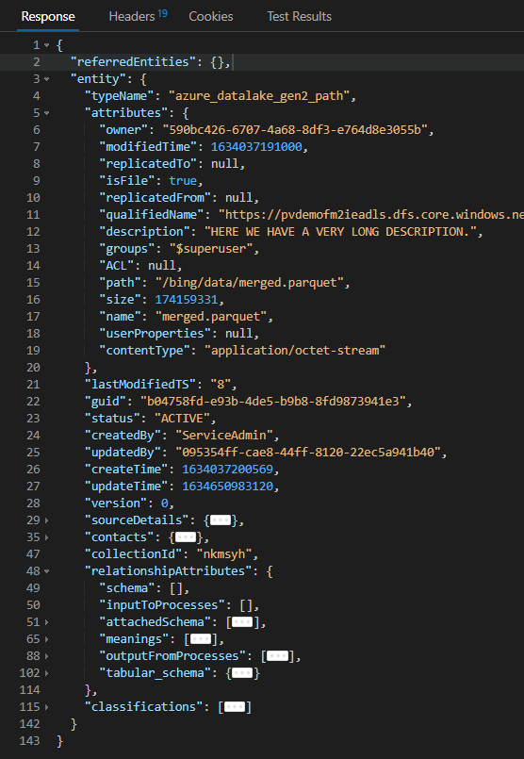
💻Type System
1
2
Referenceable
Attributes qualifiedName replicatedFrom replicatedTo | Relationships meanings
Asset
Attributes name description owner | Relationships meanings
3
4
DataSet
Attributes | Relationships schema inputToProcesses attachedSchema meanings outputFromProcesses tabular_schema
azure_datalake_gen2_path
Attributes path isFile size modifiedTime userProperties contentType ACL owner groups | Relationships schema inputToProcesses attachedSchema meanings outputFromProcesses tabular_schema

Slide 11
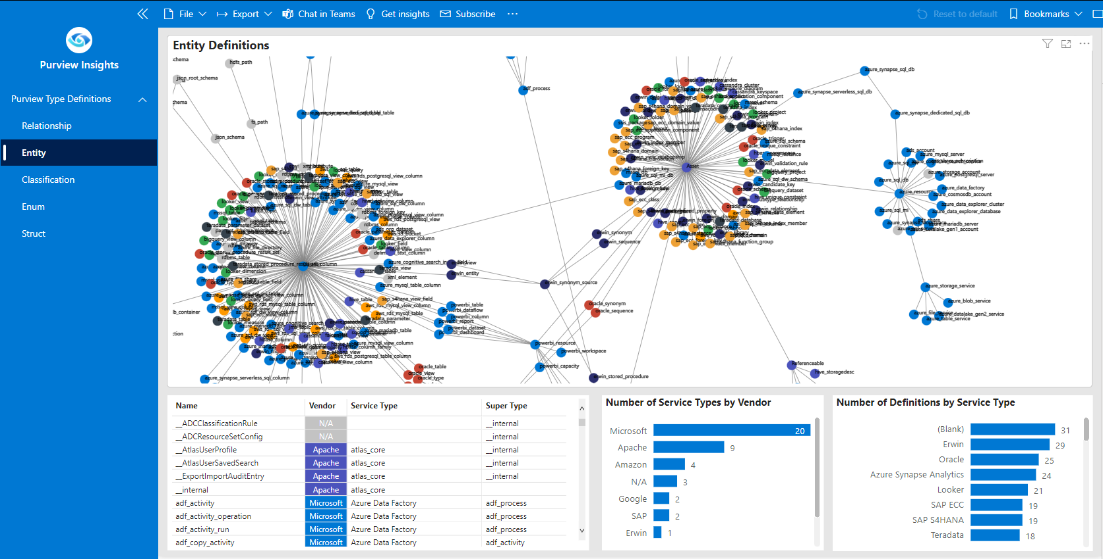
💻Type System

Slide 12
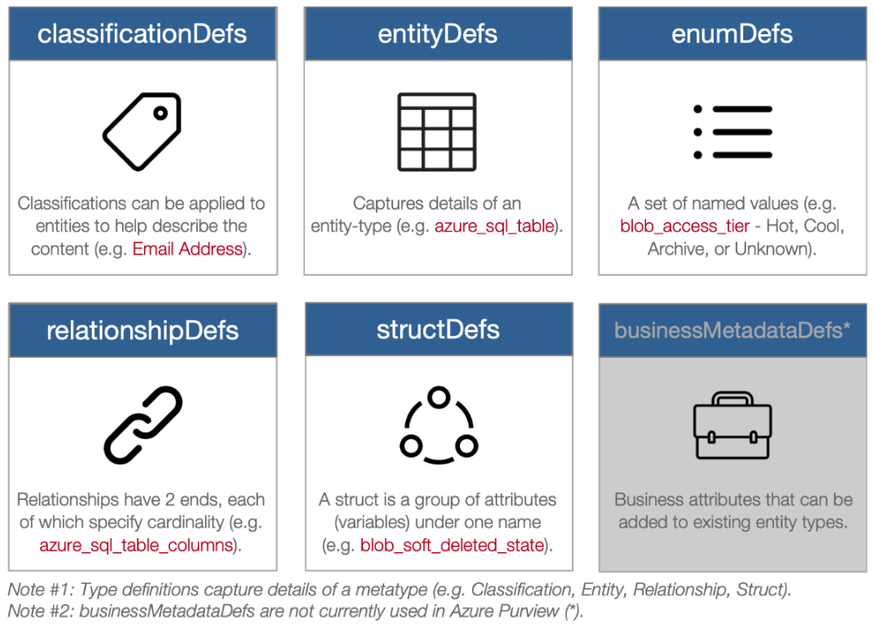
⚙ Type Definitions

Slide 13
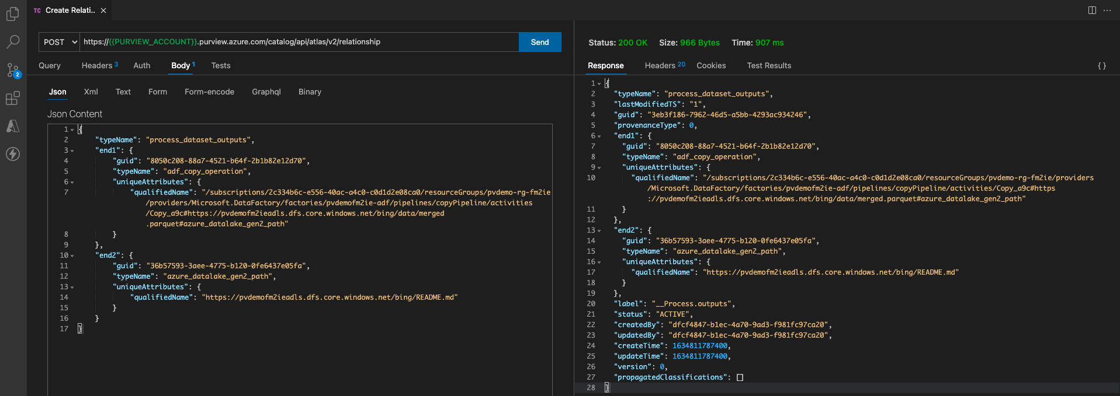
🎮 CRUD with Relationships and Custom Lineage

Slide 14
📚 Additional Resources
[MS Docs] Microsoft Purview REST API
[MS Docs] Microsoft Purview Automation Best Practices
[YouTube] Azure Purview REST API Deep Dive
[Community] PyApacheAtlas - Python SDK
[Community] purviewcli - Command Line Interface

Slide 15
Thank You 👋

